Slide 1
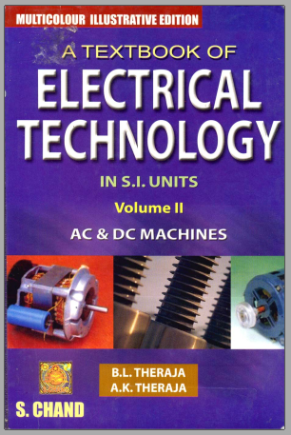
Electromagnetism
and
Fundamental Law’s

Slide 2
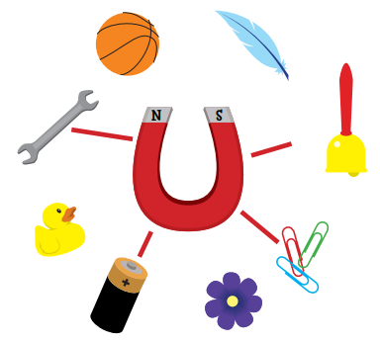
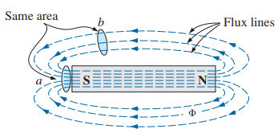
Magnets
A magnet is a piece of metal that can pull certain types of metal toward itself.
The force (which pulls the material) of magnets, called magnetic field or magnetism, is a basic force of nature, like gravity.
The magnetic field of magnet can be represented by imaginary lines (which is invisible) around magnet which are called magnetic lines of force or lines of magnetic flux.
The magnetic lines of force or lines of magnetic flux radiate from the north pole to the south pole, returning to the north pole through the metallic bar. That means, each flux line forms a closed loop.
2

Slide 3
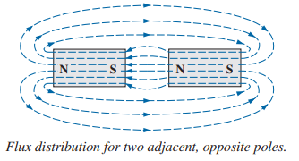
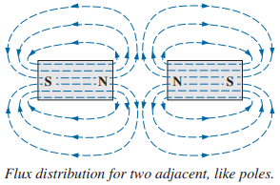
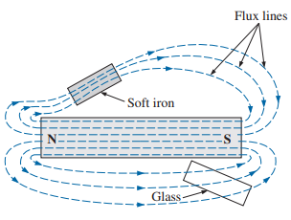
If unlike poles of two magnets are brought together, the magnets attract.
If like poles of two magnets are brought together, the magnets repel.
If a nonmagnetic material, such as glass or copper, is placed in the flux paths surrounding a magnet, an almost unnoticeable change occurs in the flux distribution.
If a magnetic material, such as soft iron, is placed in the flux path, the flux lines pass through the soft iron rather than the surrounding air because magnetic flux lines pass with greater ease through magnetic materials than through air.
3

Slide 4
Types or Classification of Magnets
Types of Magnet:
(a) Permanent Magnet:
(i) Natural: Obtained in a rock
(ii) Artificial: Made of a material that remains magnetized for long periods of time without the need for an external source of energy.
Diamagnetic: Materials that have permeabilities (μ = μ₀μ_{r} where μ₀ = 4π×10⁻⁷ Wb/A-m) slightly less than that of free space are said to be diamagnetic [Example: mercury, silver, carbon, copper etc.].
Paramagnetic: Materials that have permeabilities slightly greater than that of free space are said to be paramagnetic [Example: uranium, platinum, tungsten, aluminum, lithium etc.].
Ferromagnetic: Materials that have permeabilities is very high such as hundreds and even thousands of times that of free space are said to be ferromagnetic [Example: iron, nickel, steel, cobalt, and alloys of these metals].
(b) Electromagnet: Perform same as magnet due to the flow of charge, or current in a conductor or coil or winding.
4

Slide 5
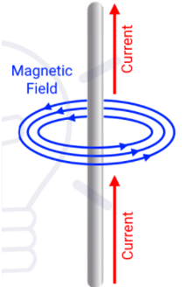
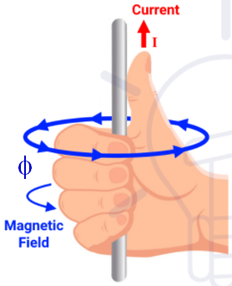
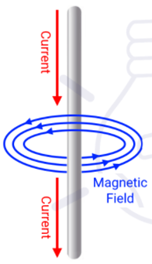
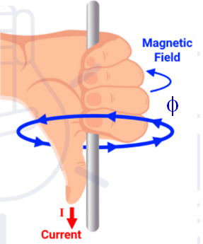
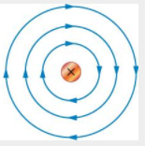
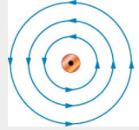
Electromagnetic Induction
Electromagnet due to Straight Current Carrying Conductor:
When a straight conductor carries a current, a magnetic flux is produced around the conductor all along its length. The magnetic flux lines will be in the form of concentric circles around the conductor. The direction of the magnetic flux lines is conveniently obtained by the Right−Hand Thumb/Grip Rule.
Current flowing away from viewer
Current flowing towards viewer
Right−Hand Thumb/Grip Rule: Suppose that a current carrying conductor is held in the right hand and the fingers are wrapped or curled around the conductor and the thumb finger is stretched in the direction of current flow. Then wrapped or curled fingers will give the direction of circular magnetic flux line.
5

Slide 6
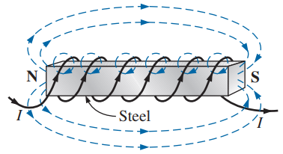
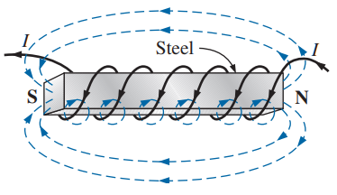
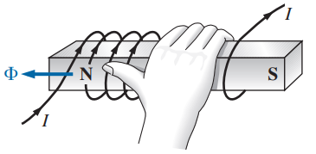
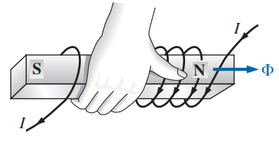
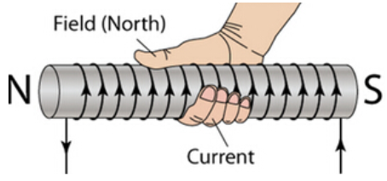
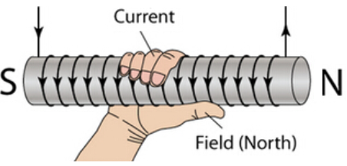
Electromagnet due to Circular Conductor (Coil) or Solenoid:
A solenoid is an arrangement in which long conductor is wound or wrapped with number of turns close together to form a coil.
When a coil or solenoid is excited by the supply voltage so that it carries a current then it produces a magnetic field which acts through the coil along its axis and also around the solenoid. The direction of the magnetic flux lines is conveniently obtained by the Right−Hand Thumb/Grip Rule.
Right−Hand Thumb/Grip Rule: Suppose that a current carrying coil or solenoid is griped such that the curled fingers in the direction of current flow. Then the thumb finger represents the direction of flux or the North pole of a magnet.
6

Slide 7
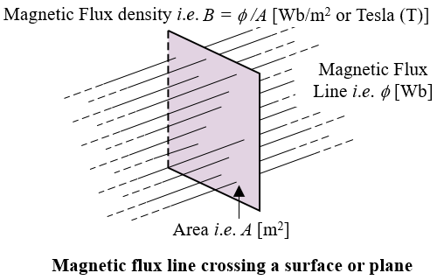
Some Definitions Related to Electromagnetic Induction
Magnetic Flux [Φ or φ]: The total number of magnetic lines of force existing in a particular magnetic field is called magnetic flux. The unit of magnetic flux is weber (Wb). It is denoted by Greek letter Phi (Φ for dc; φ for time varying case)
1 weber = 10⁸ magnetic lines of force
Magnetomotive Force (MMF) or Ampere-turns: The product of number of turns of a coil and current is called magnetomotive force or ampere-turns.
MMF = NI [AT]
Magnetic Field Strength or Magnetic Field Intensity or Magnetizing Force [H]: The magnetomotive force per unit length is called magnetic field strength or magnetic field intensity or magnetizing force.
Flux Density [B]: The magnetic flux [Φ or φ] per unit area (A) in a plane at right angles to the flux is known as flux density. The unit of magnetic flux is Wb/m² or Tesla [T]. It is denoted by B
Absolute Permeability [μ]: The ratio of flux density (B) in a particular medium (other than vacuum or air) to the magnetic filed intensity (H) producing that flux is called absolute permeability of that medium.
7

Slide 8
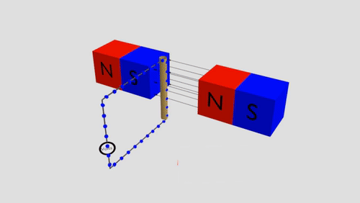
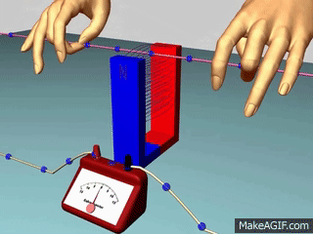
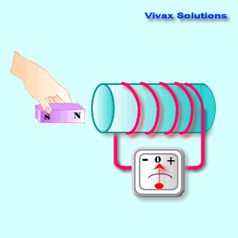
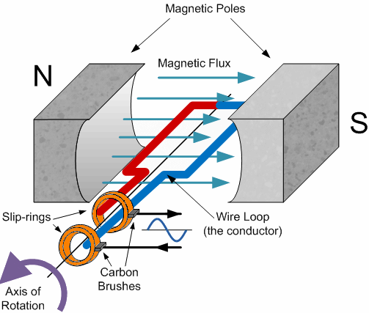
Faraday’s Law of Electromagnetic Induction
Lenz’s Law
Statement of Faraday’s Law 1: An induced emf is established in a conductor or circuit whenever the magnetic filed linking that conductor or circuit is changed.
To determine the polarity of induced emf, Lenz’s law is applied.
Statement of Faraday’s Law 2: The magnitude of induced emf is equal to the rate of change of flux linkages (dφ/dt) with the coil.
Statement of Lenz’s law: The direction of an induced emf produced by the electromagnetic induction is such that it sets up a current which always opposes the cause that is responsible for inducing the emf.
According Faraday’s law 2 and to Lenz’s law, an induced emf is mathematically expressed as follows:
8

Slide 9
Nature of Induced EMF
EMF gets induced in a conductor, whenever there exists change in flux with that conductor, according to Faraday’s law. Such change in flux can be brought about by the following methods:
(a) Statically Induced EMF:
By using a stationary conductor, a stationary electromagnet and varying the magnetic flux by supplying ac current to the electromagnet. This principle is used in transformer.
(b) Dynamically Induced EMF:
(i) By using a stationary permanent magnet (or an electromagnet fed by dc current) and a moving conductor. This principle is used in all dc generators and motors.
(ii) By using a stationary conductor, a rotating or moving permanent magnet (or an electromagnet). This principle is used in large synchronous generators and motors.
(iii) By using a stationary conductor which produced rotating or moving flux, a rotating or moving conductor with a relative speed between rotating flux and rotating conductor. This principle is used in an induction generators and motors.
9

Slide 10
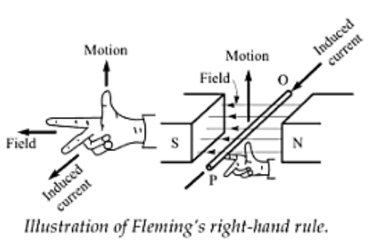
Magnitude of Dynamic Induced EMF
Fleming’s Right-Hand Rule
Although the direction of induced emf could be determined by Lenz’s law, it is found more convenient to use Fleming’s Right-Hand Rule.
Simple construction of a generator
Magnitude of Induced voltage or emf affected by flux density (B), the effective length of conductor (l), the conductor velocity (v) and sine of angle (α) between flux line and the direction of motion of conductor.
Statement of Fleming’s Right-Hand Rule: Stretch the first (fore) finger, the second (middle) finger and the thumb finger of right hand in mutually perpendicular direction to each other. Arrange the right hand so that first finger point in the direction of flux line (North pole to south pole) and thumb in the direction of motion of conductor then the middle finger will point in the direction of current (or emf).
10

Slide 11
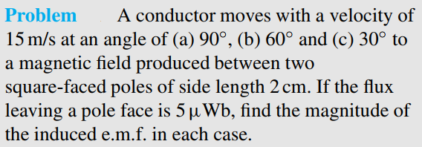
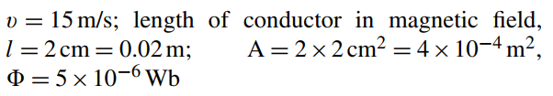
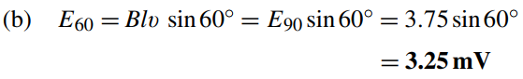
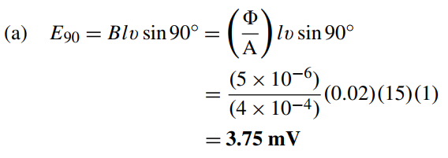
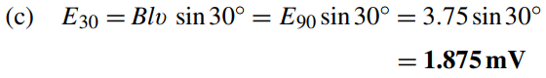
Solution:
11

Slide 12
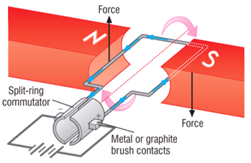
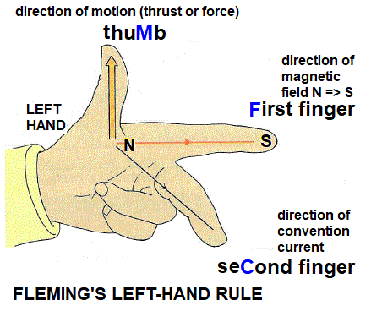
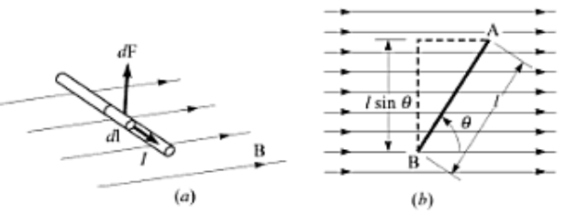
Force on a Current Carrying Conductor in A Magnetic Field
Lorentz or Electromagnetic Force: When a current-carrying conductor is placed in a magnetic field, a force is developed or produced or established on the conductor which is called electromagnetic force, or Lorentz force.
This force constitutes the basis of operation of motors.
The direction of the magnetic flux lines is conveniently obtained by the Fleming’s Left-Hand Rule.
Statement of Fleming’s Right-Hand Rule: Stretch the first (fore) finger, the second (middle) finger and the thumb finger of right hand in mutually perpendicular direction to each other. Arrange the right hand so that first finger point in the direction of flux line (North pole to south pole) and the middle finger to the direction of current then thumb will point in the direction of force of conductor.
Magnitude of Force: Force on a current carrying conductor affected by flux density (B), the effective length of conductor (l), the current (v) and sine of angle (α) between flux line and the direction of motion of conductor.
12

Slide 13
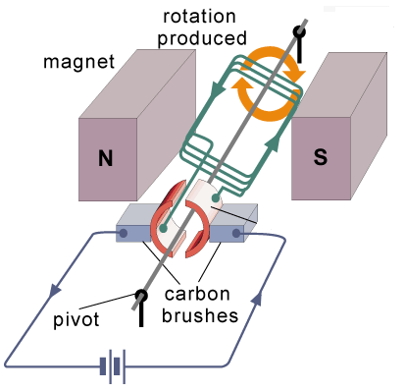
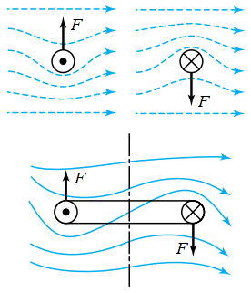
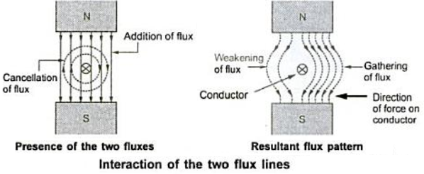
How a Force and Torque are Produce on the Conductor?
There is presence of two magnetic field. The force is created due to the interaction with each other.
Left side of conductor, conductor flux opposes the permanent magnet flux. Due to the interaction, the resultant left flux is weakening.
Right side of conductor, conductor flux assists with the permanent magnet flux. Due to the interaction, the resultant right flux is strengthening/accumulating.
Conductor experiences a force from high flux lines area towards low flux lines area i.e. from right to left.
In an electrical machine, the direction of two conductor sides are different.
The developed forces in two sides are opposite direction.
The opposite direction of two sides forces are developed torque/rotation on shaft of electrical machine.
13

Slide 14
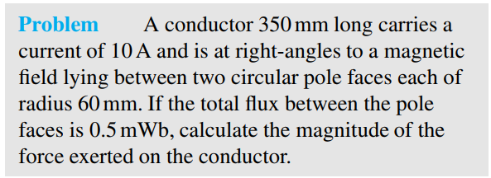
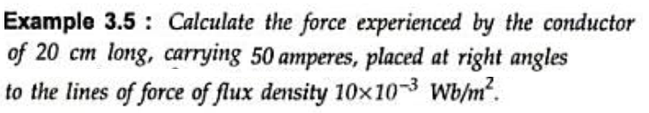
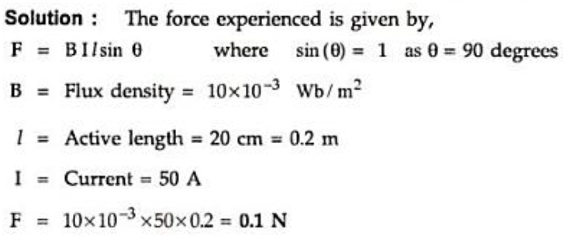
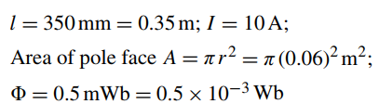
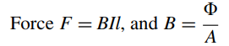
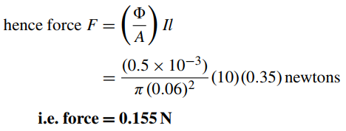
Solution:
14

Slide 15
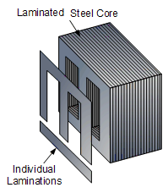
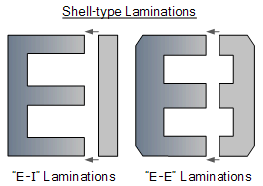
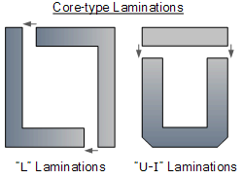
Losses of Electrical Machine
Losses of Electrical Machines:
(a) Copper (Cu)/I²R Losses (P_{Cu}):
(b) Stray Losses (P_{st}):
Hysteresis Loss: Since the flux in a transformer core is alternating, power is required for the continuous reversals of the elementary magnets of which the iron is composed. This loss is known as hysteresis loss.
Losses in different windings or coils
Eddy-Current Loss: Due to the alternating flux an emf is induced in core and current flows to the core due to this emf. This current is called eddy current. The power loss due to the eddy current is called eddy current loss. By using thin laminations, insulated in core, a small portion of eddy current loss can be reduced.
(I) Core or Iron Losses (P_{i}):
(II) Mechanical Losses (P_{mech}):
(i) Eddy Current loss (P_{e})
(ii) Hyteresis loss (P_{h})
(i) Friction loss (P_{f})
(ii) Windage loss (P_{w})
15

Slide 16
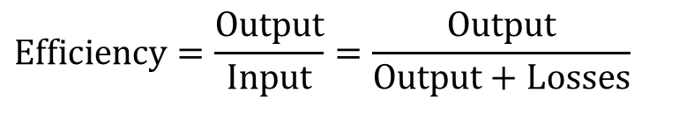
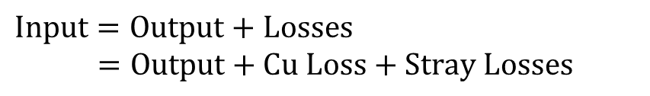
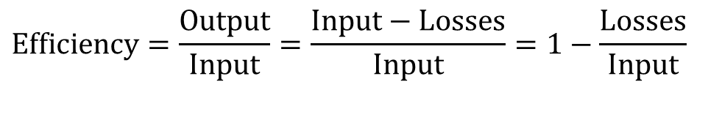
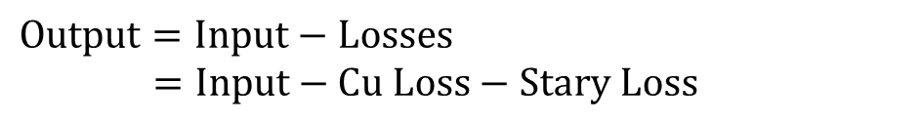
Efficiency of Electrical Machine
$$\text{Input}=\text{Output}+\text{Losses} \\ =\text{Output}+\text{Cu} \text{Loss}+\text{Stray} \text{Losses}$$
$$\text{Efficiency}=\frac{\text{Output}}{\text{Input}}=\frac{\text{Output}}{\text{Output}+\text{Losses}}$$
$$\text{Output}=\text{Input}−\text{Losses} \\ =\text{Input}−\text{Cu} \text{Loss}−\text{Stary} \text{Loss}$$
$$\text{Efficiency}=\frac{\text{Output}}{\text{Input}}=\frac{\text{Input}−\text{Losses}}{\text{Input}}=1−\frac{\text{Losses}}{\text{Input}}$$
16

Slide 17
Self Inductance
Leakage Inductance
Mutual Inductance

Slide 18
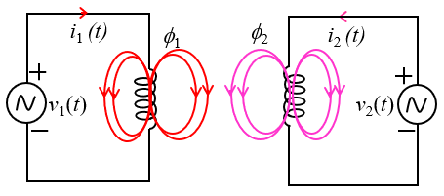
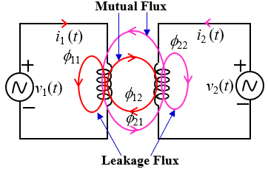
Self Flux, Leakage Flux and Mutual Flux
Self Flux: The total flux which is generated by a supplying current through a coil in an electromagnetic system is called self flux.
φ₁ is self-flux which is produced by the current i₁.
φ₂ is self-flux which is produced by the current i₂.
Leakage Flux: The portion of self-flux does not link with other coils is called leakage flux. (due to current i₁)
φ₁₁ (due to current i₁) and φ₂₂ (due to current i₂) are leakage flux.
Mutual Flux: The portion of self-flux links with other coils is called leakage flux.
φ₁₂ (due to current i₁ and link to coil 2) and φ₂₁ (due to current i₂ and link to coil 1) are mutual flux.
18

Slide 19


Self Inductance, and Mutual Inductance
If a time-changing source [v₁(t)] as shown in Figure (a) is applied to a coil 1, the produced self−flux [φ₁(t)] also will be time-changing. According to Faraday’s law of Electromagnetic Induction an emf e₁(t) [due to self−flux φ₁(t) since φ₁(t) links in coil 1] and an emf e₁₂(t) [due to mutual flux φ₁₂(t) since φ₁₂(t) links in coil 2] are induced.
Similarly, for Figure (b) we have:
The induced emfs can be given by:
L₂ and M₂₁: Self inductance of coil 2 and Mutual
inductance due to current 2 in coil 1
N₁ and N₂: Number of turns of coil 1 and coil 2
L₁ and M₁₂: Self inductance of coil 1 and Mutual
inductance due to current 1 in coil 2
Figure (a)
Figure (b)
19

Slide 20


It should also be pointed out that if a current (and therefore a magnetic field) were present in the second coil as shown in Figure (c), an additional voltage would be induced across coil 1. The voltage induced across a coil is, in general, equal to the sum of the voltages induced by self-inductance and mutual inductance. Thus, we have:
M₁₂ and M₂₁ are equal if the medium of mutual fluxes of φ₁₂(t) and φ₁₁(t) are same, thus we have:
Polarity of induced emf due to mutual flux: The dots shown in the two figures indicate the polarity of the induced emf between the coils.
If the dots are at the same end of the coils, the voltage induced in coil 2 by a current in coil 1 has the same polarity as the voltage induced by the same current in coil 1; otherwise, the voltages are in opposition, as shown in Figure (b). Thus, the presence of such dots indicates that magnetic coupling is present between two coils.
Figure (c)
20

Slide 21
Electric Machine
1. Transformer
2. Generator
3. Motor

Slide 22
Transformer
Chapter 21 [Text Book 1]
Chapter 32 [Text Book 2]

Slide 23






Transformer
23

Slide 24



Definition of Transformer
Cores: There are two basic types of Magnetic cores:
(a) Core Type: the windings surround a considerable part of the core
(b) Shell Type: the core surrounds the considerable portion of the windings
Transformer is a static device which transfers the electrical energy from one circuit to another circuit by raising or lowering the voltage without changing frequency.
Transformers are used in both communication and power circuits.
Construction of Transformer
There are two basic parts of a transformer:
(a) Windings, and (b) Magnetic cores
Windings: In a conventional transformer there have high voltage (HV) and low-voltage (LV) windings.
Primary (or driving) winding/coil/side [either HV or LV]: The winding at which source is connected is called primary winding.
Secondary (or Receiving) winding/coil/side [either HV or LV]: The winding at which load is connected is called primary winding.
https://www.youtube.com/watch?v=XrIXioEn3yQ
24

Slide 25


Working Principle of Transformer
When the primary winding is excited by an alternating voltage (v_{g} or v₁), an alternating current (i_{p} or i₁) starts to flow in primary side.
The alternating current sets up an alternating flux
[φ(t) = Φ_{m}sin(2πf)t = Φ_{m}sinωt Wb] in the core.
The secondary winding is linked by most of this flux. According to Farady’s Law of Electromagnetic Induction emfs in primary side (e_{p} or e₁) and secondary side(e_{s} or e₂)] are induced.
According to Lenz’s Law primary side emf (e_{p} or e₁) opposes the supply voltage (v_{g} or v₁). The primary side emf (e_{p} or e₁) is called back emf since it limits the flow of primary side current (i_{p} or i₁).
If the secondary side circuit is closed, the secondary current (i_{s} or i₂) flows through the load. This is way energy is transferred from primary circuit to the secondary circuit through the medium of the magnetic field.
When secondary current flows, it sets up a flux which is reduced the mutual flux. Then primary emf is reduced therefore primary current increases as well as primary fluxes is increased. Finally, the mutual flux will be back to its the previous values. So, the load current cannot change the mutual flux in the core.
Ferromagnetic core
Here,
v_{L} or v₂: Load voltage
N_{p} or N₁: Number of turns of primary side
N_{s} or N₂: Number of turns of secondary side
Z_{L} : Load impedance
25

Slide 26

32.6 EMF Equation of a Transformer
32.7 Voltage Transformation Ratio (K)
Let, the expression of developed flux in core due the supply ac voltage (v_{g} or v₁) is:
From the Eqs. (i) and (ii), we have:
Based on the Faraday’s Law, the expression induced voltage in primary side and secondary side can be obtained as follows:
This constant K is called voltage transformation ratio or transformation ratio or turns ratio.
If the losses of a transformer are neglected, then
V₁ = E₁; V₂ = E₂ and
input VA = output VA,
that means:
The RMS Value of e₁(t) and e₂(t) are as follows:
Hence, currents are the inverse ratio of the (voltage) transformation ratio.
26

Slide 27










Solution:
Solution:
27

Slide 28







Solution:
28

Slide 29




Solution:
29

Slide 30
Classification of Transformer Based on Voltage Level
Based on the voltage level in primary side and secondary side transformer are two types:
Step-up Transformer: If secondary side voltage (V₂) is greater than the primary side voltage (V₁) that means K>1 then transformer is called step up transformer.
Step-down Transformer: If secondary side voltage (V₂) is smaller than the primary side voltage (V₁) that means K<1 then transformer is called step up transformer.
Others Classification of Transformer
According to Service Conditions:
(a) Power transformer
(b) Distribution transformer
(c) Instrument Transformer
(i) Current transformer (CT)
(ii) Potential transformer (PT or VT)
According to Volt-Ampere and Voltage Ratings:
(a) Low voltage transformer [V_{HV} < 1.1 kV]
(b) Medium voltage transformer [1.1 kV ≤V_{HV} < 11 kV]
(c) High voltage transformer [V_{HV} ≥ 11 kV]
According to Type of Cooling:
Natural cooled: natural air cooled and oil immersed
natural cooled
(b) Forced cooled: air blast cooled and oil immersed air
blast cooled
(c) Water cooled: oil immersed water cooled
According to Winding:
(a) Single-phase transformer
(b) Three phase transformer
(c) Auto Transformer
30

Slide 31
Transformer Test
The performance of a transformer can be calculated on the basis of its equivalent circuit. The parameters of equivalent can easily be determined by two tests:
(a) Open-Circuit Test: Performing the open-circuit test, the core loss resistance (R₀) and magnetizing (or mutual) reactance (X₀) can be obtained.
(b) Short-Circuit Test: Performing the short-circuit test, the windings resistance (R₁ and R₂) and the leakage reactances (X₁ and X₂) can be obtained.
Why Transformer Rating is kVA?
From the two test it is seen that, the Cu loss of a transformer depends on current and core loss on voltage. Hence total transformer loss depends on volt-ampere (VA) and not depends on the phase difference between voltage and current i.e. it is independent of load power factor. That is why rating of transformer is in kVA and not kW.
31

Slide 32
Regulation of Transformer
When the secondary of a transformer is loaded, the secondary terminal voltage, V₂, falls.
As the power factor decreases, this voltage drop increases. This is called the regulation of the transformer and it is usually expressed as a percentage of the secondary no-load voltage, E₂. For full-load conditions:
The fall in voltage, (E₂− V₂), is caused by the resistance and reactance of the windings.
Typical values of voltage regulation are about 3% in small transformers and about 1% in large transformers.
32

Slide 33







Solution:
33

Slide 34




34

Slide 35



Some Applications of Transformer
To step up or step down voltage and current (useful for power transmission and distribution).
To isolate one portion of a circuit from another.
35

Slide 36


As an impedance matching device for maximum power transfer.
Frequency-selective [Resonance or Filter] circuits.
36

Slide 37
Basic of Electrical Machines
B. L. Theraja, A. K. Theraja, “A Textbook of ELECTRICAL TECHNOLOGY in SI Units Volume II, AC & DC Machines,” S. Chand & Company Ltd.

Slide 38



Electromechanical Energy Conversion Principles
According to the energy conversion principle, energy is neither created nor destroyed: it is simply changed in form.
Generator: The electrical machine which converts form mechanical energy to electrical energy is called generator.
EMF or voltage is induced according to Faraday’s law since conductor is moved inside magnetic field.
p_{in}=p_{m}=Tω_{m}
A rotational electromagnetic machine (also called electrical machine) converts energy from mechanical to electrical form, or vice versa.
p_{out}=p_{e}=vi
Motor: The electrical machine which converts form electrical energy to mechanical energy is called motor.
p_{out}=p_{m}=Tω_{m}
According to Lorentz Force theory, rotation is obtained due to the developed force in the current carrying conductors inside a magnetic field.
p_{in}=p_{e}= vi
38

Slide 39


Some Basic Mathematical Relation of Electrical Machines
Electrical Power:
Mechanical Power and Torque:
$$T=\frac{P_{m}}{ω_{m}} [Nm]$$
$$P_{m}=Tω_{m}[W]$$
Electrical Angular velocity (ω) and Mechanical Angular velocity (ω_{m}):
Speed :
T : Torque in N−m
f : Frequency in Hz
P : Number of magnetic pole always in even number
39

Slide 40
Classification of Electrical Machines
Electrical Machines Broadly Classy as Follows:
(A) DC (or Commutator) Machine
(B) AC (or Commutatorless) Machine
(C) Special Type Machine
(a) Based on the number of phase:
(i) Single-phase Machine (ii) Three-phase Machine
Universal Motor
Shaded-pole Motor
Synchronous Reluctance Motor
Hysteresis Motor
Stepper Motor
Servo Motor
Linear Motor
so on ……….
(b) Based on the running speed:
(i) Synchronous Machine
run at synchronous speed
(ii) Induction (Asynchronous) Machine
run at below synchronous speed
40

Slide 41



Basic Elements and Parts of Electrical Machine
In an electrical machine must have the followings two basic essential parts:
(a) Armature or Conductor where emf is induced or voltage is supplied.
(b) Magnet either permanent magnet or electromagnet where force/rotation is established.
In broad sense, electrical machine has two major parts:
(a) Stator: The portion/part of electrical machine which is stationary is called stator.
(b) Rotor: The portion/part of electrical machine which is rotating is called rotor.
DC machine
In a DC machine, Magnet is in stator and armature is in rotor.
In an AC machine, Armature is in stator and magnet is in rotor.
AC machine
41

Slide 42


AC Generation and DC Generation
In a generator, an emf is induced in a conductor according to Farady’s law.
The polarity of induced emf can be determined by Flaming’s Right Hand Rule.
The induced emf in a rotating machine is changed sinusoidally because the direction of force of conductor is changed alternately from up−ward to down −ward or down −ward to up −ward.
The load cannot be connected directly to load. Loads are connected through brushes. Brushes are in contact continuously with slip-rings (to get ac output) or commutator segments (to get dc output).
Slip-rings are used to supply current to load for ac voltage. Here, both slip-rings and brushes are fixed. A conductor is always in touch with slip ring.
Commutator-segments are used to supply current to load for dc voltage. Here, commutator is rotating with conductor and brushes are fixed. One brush is collected current from the positive induced voltage. On other hand, another brush is collected current from the negative induced voltage.
So, the output voltage across a load is ac since the induced emf in the conductor is sinusoidal.
Commutator helps to convert ac induced emf to dc emf.
By increasing the number of conductors, the pulsation of dc voltage can be reduced
42

Slide 43
DC Machines
Chapters 26 and 29
B. L. Theraja, A. K. Theraja, “A Textbook of ELECTRICAL TECHNOLOGY in SI Units Volume II, AC & DC Machines,” S. Chand & Company Ltd.

Slide 44



Construction of DC Machines
Stator [Magnet]
Magnetic pole core and pole shoe
Frame or Yoke
Field (Shunt and series) winding
Interpole or Commutating pole
Compensating
Terminal box
Rotor [Conductors or Armature]
Armature Core
Armature Slots
Armature winding
Bearing and Shaft
Commutator and Brushes
44

Slide 45



Classification of DC Machines
DC Machines are Classified as follows:
(1) Permanent Magnet DC Machine: Where permanent magnet is used for magnetic flux.
(2) Electromagnetic based DC Machine: Where electromagnet is used to produce magnetic flux. Mainly this type of DC machine has two field windings, the are called shunt winding and series winding.
(a) Separately Exited DC Machine: where the field winding is connected to a source of supply other than the armature of its own machine
(b) Self-exited DC Machine: where the field winding receives its supply from the armature of its own machine.
Permanent Magnet DC Machine
Separately excited DC Machine
Self-excited DC Machine
45

Slide 46



Self-Exited DC Machine are three types based on field winding connection with armature:
(i) Shunt Wound DC Machine: where the only shunt (parallel) field winding is connected in parallel with armature winding.
(ii) Series Wound DC Machine: where the only series field winding is connected in series with armature winding.
(iii) Compound Wound DC Machine: where the both shunt (parallel) and series field windings are connected.
(I) Long Shunt Wound DC Machine: where shunt field winding is connected parallel with in combination of series connection of armature and series field winding.
(II) Short Shunt Wound DC Machine: where series field winding is connected series with in combination of parallel connection of armature and shunt field winding.
Shunt Wound
Series Wound
Short Shunt
Long Shunt
Compound Wound
46

Slide 47


Compound Wound DC Machine is two types based on the relative shunt flux and series flux:
(a) Cumulative Compound DC Machine: where series field flux aids with shunt field flux.
(b) Differential Compound DC Machine: where series field flux opposes with shunt field flux.
Short Shunt Cumulative Compound DC Machine
Short Shunt Differential Compound DC Machine
Long Shunt Cumulative Compound DC Machine
Long Shunt Differential Compound DC Machine
47

Slide 48
DC Generator
Chapters 29
B. L. Theraja, A. K. Theraja, “A Textbook of ELECTRICAL TECHNOLOGY in SI Units Volume II, AC & DC Machines,” S. Chand & Company Ltd.

Slide 49




Working Principle of a DC Generator
Let, a coil is rotating clock-wise direction having two sides AB and CD (Fig. 26.2). As the coil cuts the magnetic field, according to Faraday’s law of electromagnetic induction an emf is induced in it which is proportional to the rate of change of flux (e=Ndφ/dt).
When the coil side AB is at position 1, it produces zero EMF because the flux linked with the coil is maximum but rate of change of flux is zero.
As it moves in the clockwise direction, the rate of change of flux increases so does the EMF.
When the conductor portion is at position 2, it produces maximum EMF because the flux linked with the coil is minimum but rate of change of flux is maximum.
At position 3, the EMF is zero, at position 4 negative maximum and at position 5 zero again.
The wave shape of the generated EMF which is shape is sinusoidal is given in Fig. 26.3.
The sinusoidal voltage is converted to dc voltage by using commutator segment.
49

Slide 50
EMF Equation of DC Generator
The developed emf (E_{g}) per parallel path of a DC generator is given by:
Φ = Flux/pole [Wb]
Z = Total number of armature conductor
= Number of Slots × (Number of conductor/slot)
= 2 × Number of turns
P = Number of generator poles
N = Armature rotation in revolution per minute (rpm)
ω_{m} = Armature rotation in rad/s
A = Number of parallel paths in armature
= 2 for wave winding
= P for lap winding
E_{g} or E_{a} = EMF induced in any of the parallel paths
For a given DC machine, Z, P, A are constant, thus Eq. (26.1) can be written as follows:
For an electromagnetic system flux is proportional to field current i.e. Φ ∝ I_{f}. So, Eq. (26.2) can be written as follows:
K₁ and K₂ are constant
I_{f} = I_{sh} for shunt wound DC motor
= I for series wound DC motor
50

Slide 51


51

Slide 52




Power Stages of a DC Generator
The various power stages in a DC generator are represented diagrammatically in Figure below.
A – B = Iron and Friction Losses
B – C = Copper (Cu) Losses
52

Slide 53
Applications of DC Generator
Primarily used in laboratory and commercial testing
Speed regulation Tests
Supplying power to the DC motors, whose speed being to be controlled
Separately Excited DC Generators
Voltage boosting in the feeders in the various types of distribution systems
Used to provide high voltage DC power transmission at constant load current
In supplying field excitation current in DC locomotives for regenerative breaking
Arc lightening
Series wound DC Generators
Shunt wound DC Generators
Battery charging applications
Lighting and power supply purposes
Excitation to the alternators
Over compounded generators are used in supplying loads through long transmission lines.
Cumulative compound generators are used for supplying power to DC motors and for lighting, power supply purposes and for heavy power services, etc.
The differential compound generators are used for arc welding purposes where a large voltage drop and constant current is required.
Compound wound DC Generators
53

Slide 54
DC Motor
Chapters 29
B. L. Theraja, A. K. Theraja, “A Textbook of ELECTRICAL TECHNOLOGY in SI Units Volume II, AC & DC Machines,” S. Chand & Company Ltd.

Slide 55



Working Principle of a DC Motor
Consider a part of a DC. motor as shown in Figure DCM 01. When the terminals of the motor are connected to DC supply:
(i) the field magnets are excited developing alternate N and S poles.
(ii) the armature conductors carry currents. All conductors under N-pole carry currents in one direction while all the conductors under S-pole carry currents in the opposite direction.
Figure DCM 01
Since each armature conductor is carrying current and is placed in the magnetic field, mechanical force (F) Developed on it as shown in Figure DCM 02.
Referring to Figure DCM 01 and Figure DCM 01 and applying Fleming’s left hand rule, it is clear that force on each conductor is tending to rotate the armature in anticlockwise direction.
Force of individual conductor add together to produce a driving torque which sets the armature rotating.
Figure DCM 02
55

Slide 56


Back or Counter EMF
Electromagnetic Torque Equations
When the armature conductor of a DC. motor rotates through the magnetic field an emf is induced (Faraday’s Law). The induced emf acts in opposite direction to the applied voltage (Lenz’s law) and in known as back or counter emf which is given by:
The product E_{b}I_{a} known as the electromagnetic power (P_{em}) (which is developed in armature) being converted, is related to the electromagnetic torque by the relation:
$$E_{b}=K_{n}ΦN=K_{ω}Φω_{m}=K_{2}I_{f}ω_{m} (29.1.1)$$
Combining Eq. (29.1) and Eq. (29.3) the electromagnetic torque can be written as follows:
$$E_{b}=V−I_{a}R_{a} (29.1.2)$$
From Eq. (29.1), we have:
For an electromagnetic system flux is proportional to field current i.e. Φ ∝ I_{f}. So, Eq. (29.3) can be written as follows:
K₁ = Constant
I_{f} = I_{sh} for shunt wound DC motor
= I for series wound DC motor
56

Slide 57
Applications of DC Motor
Types of Motor
Characteristics
Applications
Approximately Constant Speed
Adjustable Speed
Medium starting torque
For driving constant speed line shafting lathes
Centrifugal and Reciprocating pumps
Machine tools
Blowers and fans
Shunt wound DC Generators
Series wound DC Generators
Variable Speed
Adjustable varying Speed
High starting torque
For Traction work i.e. Electrical locomotives
Rapid transit systems
Trolley, cars etc.
Cranes and hoists
Conveyors
Variable Speed
Adjustable varying Speed
High starting torque
For intermittent high torque loads
For sheares and punches
Elevators, Conveyors, Heavy planers
Rolling mils, Ice machines
Printing process, Air compressor
Compound wound DC Motors
57

Slide 58
EXAMPLE: A 200V d.c. shunt-wound motor has an armature resistance of 0.4 and at a certain load has an armature current of 30 A and runs at 1350 rev/min. If the load on the shaft of the motor is increased so that the armature current increases to 45 A, determine the speed of the motor, assuming the flux remains constant.
Solution: There are two cases.
In case 1: I_{a1} = 301 A, N₁ = 1350 rpm
In case 2: I_{a2} = 45 A, N₂ = ?
Since flux is remain constant: E ∝ N, thus we have
58

Slide 59
36.17 Universal Motor
B. L. Theraja, A. K. Theraja, “A Textbook of ELECTRICAL TECHNOLOGY in SI Units Volume II, AC & DC Machines,” S. Chand & Company Ltd.

Slide 60





Universal Motors
Definition: A universal motor is defined as a motor which may be operated either on DC or single-phase AC supply at approximately the same speed and output. Universal motor is also called ac series motor.
A DC series motor can be operated as a universal motor by some modification such as entire magnetic circuit is laminated, turns of series field winding is reduced, high-resistance leads (brushes) are used.
60

Slide 61

Working Principal of Universal Motors
A universal motor works on either DC or single-phase AC supply. When the universal motor is fed with a DC supply, it works as a DC series motor.
When current flows in the field winding, it produces a magnetic field. The same current also flows from the armature conductors. When a current carrying conductor is placed in an electromagnetic field, it experiences a mechanical force.
Due to this mechanical force, or torque, the rotor starts to rotate. The direction of this force is given by Fleming’s left hand rule.
If the supply is DC, the polarity never reverses. So, we get the field and the current in the same direction always and hence a net force in a particular direction on the conductors due to which the rotor rotates.
If the supply is AC, the polarity changes between +ve and –ve. So, the direction of current and the Magnetic Field changes.
Since the field is connected in series with the Armature, both the armature current and field direction changes simultaneously and as a result, the resultant force always remains in the same direction.
Thus, even if the polarity is changed, the motor continues to run in the same direction.
https://www.youtube.com/watch?v=0PDRJKz-mqE
61

Slide 62


Characteristics of Universal Motors
The speed of a universal motor varies just like that of a DC. series motor i.e. low at full-load and high on no-load (about 20,000 r.p.m. in some cases).
In fact, on no-load the speed is limited only by its own friction and windage load.
Fig. 36.48 shows typical torque characteristics of a universal motor both for DC. and AC supply.
Purpose of Governor Universal Motors
A governor (which is control the speed) may be used to maintain reasonable speeds since it is dangerous to operate at high no load speed. This governor consists of a centrifugal switch mounted on the shaft of the motor. The tension of the springs of the switch is adjusted so that the switch contacts open at a predetermined speed and thus place a resistor in series with the armature, thereby reducing the speed. When the speed falls because of loading, the switch contacts close, thereby shorting out the series resistor, thus again raising the speed. The connections are shown in Fig. 22.3. The capacitor is placed across the governor contacts to reduce sparking.
R
C
62

Slide 63
Advantages of Universal Motors
Applications of Universal Motors
High speed from above 3600 rpm to 25000 rpm
High power output in small physical sizes to use in portable tools.
High torque at low and intermediate speeds to carry a particularly severe load.
Variable speed by adjustable governor by line voltage or especially by modern pulse technique.
The universal motors have high-speed (and corresponding small size) and large starting torque. They can, therefore, be used to drive:
(a) High-speed vacuum cleaners
(b) Sewing machines
(c) Electric shavers, hair driers
(d) Drills
(e) Drink and food mixer, blender
(f) Machine tools etc.
Disadvantages of Universal Motors
Increased service requirement due to use of brushes and commutators. The life of these parts is limited in severe service.
Relatively high noise level at high speeds.
Moderate to severe radio and television interference due to brush sparking.
Requirement for careful balancing to avoid vibration.
Requirement for reduction gearing in most portable tools.
63

Slide 64
Induction Motor
Chapter 34
B. L. Theraja, A. K. Theraja, “A Textbook of ELECTRICAL TECHNOLOGY in SI Units Volume II, AC & DC Machines,” S. Chand & Company Ltd.

Slide 65



Construction of Induction Motor
Stator
An induction motor consists of two main parts:
(a) Stator (b) Rotor
Stator
The stator carries a three-phase winding and is fed from a three-phase supply. It is wound for a definite number of poles, the exact number of poles being determined by the requirements of speed. Greater the number of poles, lesser the speed and vice versa.
Rotor: The rotor of an induction is two type:
Squirrel-Cage Rotor: The squirrel-cage rotor consists of a cylindrical laminated core with parallel slots for carrying the rotor conductors. The rotor conductors are heavy bars of copper, aluminium or alloys. The rotor bars are permanently short-circuited by the two end-rings.
Phase-wound or Wound Rotor: This type of rotor is provided with three-phase double layer windings consisting of coils. One layer of winding permanently shorted, another layer winding connected with 3-slip rings to control externally from rotor side. The rotor is wound for as many poles as the number of stator poles.
Squirrel-Cage Rotor
Phase-Wound or Wound Rotor
65

Slide 66


Working Principal of an Induction Motor
When 3-phase stator winding is energized from a 3-phase supply, a rotating magnetic field is set up which rotates round the stator at synchronous speed [N_{s} = 120f/P].
The rotating field cuts the rotor conductors. Due to the relative speed between the rotating flux and the stationary rotor, emfs are induced in the rotor conductors. Since the rotor circuit is short-circuited, currents start flowing in the rotor conductors.
Since the current-carrying rotor conductors are placed in the magnetic field produced a mechanical force acts on the rotor conductors. The sum of the mechanical forces on all the rotor conductors produces a torque which tends to rotating the rotor in the same direction as that of stator field and tries to catch it.
Induction motor starts to run immediately supply the power. That’s why three phase induction motor is a self-starting motor.
The working principle of an induction motor is almost similar to a transformer except that the secondary side is rotating that’s why an induction motor is also called rotating transformer.
66

Slide 67
Synchronous Speed (N_{s}): The speed of rotating flux which is produced due to the supply of three-phase voltage in the stator of an induction motor is called synchronous speed.
At standstill (N = 0) condition the value of slip, s = 1.
If in an induction motor the rotor speed equal to the synchronous speed, no voltage will be induced in the rotor. No current and flux will be produced by the rotor circuit as well as the rotor will be rotated. So, the rotor speed of an induction motor is always less than the synchronous speed. That’s why induction motor is also called asynchronous motor.
Slip Speed (N_{sl}) : The difference between synchronous speed (N_{s}) and the actual rotor speed (N) is called slip speed.
Slip (s): The per-unit value of slip speed with respect to synchronous speed is called slip.
Under Running Condition
Frequency of Rotor Current (f_{r}):
Rotor Induced Voltage (E_{r}):
Rotor Reactance (X_{r}):
67

Slide 68


68

Slide 69


69

Slide 70
Single Phase Induction Motor
Chapter 36
B. L. Theraja, A. K. Theraja, “A Textbook of ELECTRICAL TECHNOLOGY in SI Units Volume II, AC & DC Machines,” S. Chand & Company Ltd.

Slide 71

A single-phase induction motor is, more or less, similar to a polyphase induction motor, except that: (i) (i) its stator is provided with a single-phase winding and
(ii) a centrifugal switch is used in order to cut out a winding, used only for starting purpose.
It has distributed stator winding and a squirrel-cage rotor.
When fed from a single-phase supply, its stator winding produces an alternating flux which is not a synchronously rotating flux.
An alternating or pulsating flux acting on a stationary, squirrel-cage rotor cannot produce rotation. That is why a single-phase motor is not self-starting.
However, if the rotor of such a machine is given an initial start by hand (or small motor) or otherwise, in either direction, then immediately a torque arises and the motor accelerates to its final speed.
This peculiar behavior of the motor has been explained in two ways:
(a) Two-field or double-field revolving theory
(b) Cross-field theory
Fan
Starter
Stator
Rotor
End Bell
Shaft
71

Slide 72

36.4 Making Single-Phase Induction Motor Self-Starting
To make a single-phase induction motor self-starting, the stator is provided with an extra winding known as starting (or auxiliary) winding, in addition t the main (or running) winding.
Two winding are connected in parallel across the supply and they are spaced 90º electrically apart.
It is arranged that the phase difference between the currents in the two stator windings is very large (ideal value is 90º). Hence, the motor behaves like a two-phase motor. These two currents produce a revolving flux and hence make the motor self starting.
Classification of Single-Phase Induction Motor
Single-phase induction motors are categorized based on the methods used to start them. Each starting method differs in cost and in the amount of starting torque it produces.
1. Split-Phase (or resistance-start) Motor
2. Capacitor-Start Motor
3. Capacitor-Run Motor
4. Capacitor-Start Capacitor-Run Motor
5. Shaded-Pole Motor
72

Slide 73






Split-Phase (or resistance-start) Motor
Capacitor Start Motor
Capacitor Run Motor
The auxiliary winding may be disconnected automatically by the operation of a centrifugal switch at about 75% of synchronous speed. Once the motor is started, it continues to run in the same direction.
73

Slide 74


Shaded-Pole Motor
The shaded-pole induction motor is used widely in applications that require 1/20 hp or less.
As shown in the following figure, the motor has a salient-pole construction, with one-coil-per-pole main windings, and a squirrel-cage rotor.
One portion of each pole has a shading band or coil.
The shading band is simply a short-circuited copper strap (or single-turn solid copper ring) wound around the smaller segment of the pole piece.
The current induced in the shading band causes the flux in the shaded portion of the pole to lag the flux in the unshaded portion of the pole.
Therefore, the flux in the unshaded portion reaches its maximum before the flux in the shaded portion.
The result is like a rotating field moving from the unshaded to the shaded portion of the pole, and causing the motor to produce a slow starting torque.
The shaded-pole motor is rugged, cheap, small in size, and needs minimum maintenance.
It has very low starting torque, efficiency, and power factor, and is used in turntables, motion-picture projectors, small fans, and vending machines.
74

Slide 75
Synchronous Generator
[Alternator]
Chapter 37
B. L. Theraja, A. K. Theraja, “A Textbook of ELECTRICAL TECHNOLOGY in SI Units Volume II, AC & DC Machines,” S. Chand & Company Ltd.

Slide 76
Synchronous Generator Or Alternator
Almost whole of the world, all three-phase power is generated by synchronous machines operated as generators. Synchronous generators are also called alternators and are large machines producing electrical power at hydro, nuclear, or thermal power plants.
Synchronous generators rated in excess of 1000 MVA are quite commonly used in generating stations.
The term synchronous refers to the fact that these machines operate at constant speeds and frequencies.
A given synchronous machine can operate as a generator or as a motor.
Such machines are used as motors in constant-speed drives in industrial applications and also for pumped-storage stations.
In small sizes with only fractional horsepower, they are used in electric clocks, timers, record players, and in other applications which require constant speed.
76

Slide 77




Construction of a Synchronous Generator Or an Alternator
In a synchronous machine, the armature winding is on the stator and the field winding is on the rotor.
Stator: The stator consist of a cast-iron frame, which supports the armature core, having slots on its inner periphery for housing the armature conductors.
Rotor: Rotor consists of electromagnet which have the same number of poles as the stator winding. The rotor winding is supplied from an external dc source (or converted induced emf in alternator dc voltage using rectifier) through slip rings and brushes. There are two types rotor constructions as follows:
(i) Salient (or projecting) Pole Type , and (ii) Smooth Cylindrical or Non-salient pole Type
Rotor
Armature
77

Slide 78
Working Principal of a Synchronous Generator Or an Alternator
When the rotor rotates by applying the mechanical energy, the stator conductors (being stationary) are cut by the magnetic flux, hence they have induced emf produced in individual winding.
Because the magnetic poles are alternately N and S, they induce an emf and hence current in armature conductors, which first flows in one direction and then in the other.
Hence, an alternating emf is produced in the stator conductors:
(i) whose frequency depends on the number of N and S poles moving past a conductor in a one second, and
(ii) whose direction is given by Fleming’s Right-hand rule
37.6 Speed and Frequency of an Alternator
The frequency of an alternator can relate with the speed as follows:
where, P = total number of magnetic poles
N= rotating speed of the rotor
f = frequency of generated emf in Hz
It is clear from the above that for slower engine driven alternators, their number of poles is much greater as compared to that of the turbo-generators, which run at very high speeds.
78

Slide 79

Equation of Induced EMF
The three-phase induced emf in an alternator can be given by:
a
e_{aa′}
where,
a′
c′
e_{cc′}
b′
e_{bb′}
E_{ph} = RMS value of per phase voltage
Φ = Flux/pole [Wb]
T = Number of coils or turns/phase
f = (PN_{s} /120) Frequency in Hz
N_{s} = Rotor speed in rpm
k_{w} = k_{c} k_{d} = winding factor
k_{c} or k_{p} = Pitch or chord factor [see 37.11]
k_{d} = Distribution factor [see 37.12]
c
b
79

Slide 80
Example: A 3-phase, 16 poles alternator has star-connected winding with 240 turns coil in each phase. The flux per pole is 0.03 Wb and the speed is 375 rpm. Its stator winding factor is 0.96. Find (i) the frequency, (ii) the rms value of phase voltage and line voltage of this generator, and (iii) the three phase voltages as a function of time.
Solution: Given, P = 16, T = 240, Φ = 0.03 Wb. N_{s} = 375 rpm and k_{w} = 0.96.
Practice Problem: A 3-phase, 16 poles alternator has star-connected winding with 96 turns coil in each phase. The flux per pole is 5×10⁻² Wb and the speed is 450 rpm. Its stator pitch factor is 0.966 and distribution factor is 0.96. Find (i) the frequency, (ii) the rms value of phase voltage and line voltage of this generator, and (iii) the three phase voltages as a function of time.
80

Slide 81
Synchronous Motor
Some characteristic features of a synchronous motor:
1. It runs either at synchronous speed or not at all.
2. It is not inherently self-starting.
3. It is capable of being operated under a wide range of power factors, both lagging and leading.

Slide 82
38.1 Synchronous Motor - General
A synchronous motor is electrically identical with an alternator or AC generator.
A given alternator ( or synchronous machine) can be used as a motor, when driven electrically.
Some characteristic features of a synchronous motor are as follows:
1. It runs either at synchronous speed or not at all i.e. while running it maintains a constant speed. The only way to change its speed is to vary the supply frequency (because N_{S}=120f/P).
2. It is not inherently self-starting. It has to be run up to synchronous (or near synchronous) speed by some means, before it can be synchronized to the supply.
3. It is capable of being operated under a wide range of power factors, both lagging and leading. Hence, it can be used for power correction purposes, in addition to supplying torque to drive loads.
82

Slide 83

38.2 Working Principal of Synchronous Motor
When a 3-phase winding is fed by a 3-phase supply, then a magnetic flux of constant magnitude but rotating at synchronous speed, is produced.
But half a period latter, stator poles, having rotated around, interchange their position i.e. N_{S} is at position B and S_{S} at point A. under these conditions, N_{S} attracts S and S_{S} attracts N and rotor tends to rotate clockwise.
Consider a two-pole stator of Fig. 38.2, in which are shown two stator poles (marked N_{S} and S_{S}) rotating at synchronous speed say, in clockwise direction.
Hence, we find that due to continuous and rapid rotation of stator poles, the rotor is subjected to torque which tends to move it first in one direction and then in the opposite direction.
Owing to its large inertia, the rotor cannot instantaneously respond to such quickly reversing torque, with the result that it remains stationary.
Since the two similar poles, N (of rotor) and N_{S} (of stator) as well as S and S_{S} will repel each other, the rotor tends to rotate in the anti-clockwise direction.
Now, consider the condition shown in Fig. 38.3(a) where the stator and rotor poles are attracting each other.
Suppose that the rotor is not stationary, but it is rotating clockwise, with such a speed that turns through one pole-pitch by the time the stator poles interchange their positions, as shown in Fig. 38.3(b).
Here, again the stator and rotor poles attract each other.
It means that if the rotor poles also shift their positions along with the stator poles, then they will continuously experience a unidirectional torque i.e. clockwise torque, as shown in Fig. 38.3.
83

Slide 84

38.3 Method of Staring of Synchronous Motor
There are several methods to start the synchronous motor such as:
(a) Auxiliary drive (induction motor or dc motor)
(b) Induction start (using damper winding), etc
84

Slide 85
Permanent Magnet Synchronous Motor (PMSM)
B. L. Theraja, A. K. Theraja, “A Textbook of ELECTRICAL TECHNOLOGY in SI Units Volume II, AC & DC Machines,” S. Chand & Company Ltd.

Slide 86


Definition: A permanent magnet synchronous motor (PMSM) is a motor that uses permanent magnets to produce the air gap magnetic field rather than using electromagnets.
Construction: The permanent magnet synchronous motor construction is similar to the basic synchronous motor, but the only difference is with the rotor. The rotor doesn’t have any field winding, but the permanent magnets are used to create field poles.
Based on the mounting of the permanent magnet on the rotor, the construction of a permanent magnet synchronous motor is divided into two types.
Surface-mounted PMSM: In this construction, the magnet is mounted on the surface of the rotor. It is suitable for high-speed devices like robotics and tool drives. No reluctance torque. Less robust motor.
Buried PMSM or Interior PMSM: In this type of construction, the permanent magnet is embedded into the rotor. It is suitable for high-speed applications and gets robustness. Reluctance torque is due to the saliency of the motor.
86

Slide 87
Working Principal:
The permanent magnet synchronous motor working principle is similar to the synchronous motor. It depends on the rotating magnetic field that generates electromotive force at synchronous speed. When the stator winding is energized by giving the 3-phase supply, a rotating magnetic field is created in between the air gaps.
This produces the torque when the rotor field poles hold the rotating magnetic field at synchronous speed and the rotor rotates continuously. These motors are not self-starting motors, it is necessary to provide a variable frequency power supply.
Disadvantages:
The disadvantages of PMSM are:
These type of motors are very expensive when compared to induction motors
Somehow difficult to start-up because they are not self-starting motors.
Applications:
The PMSMs applications are:
Air conditioners, Refrigerators, AC compressors
Washing machines, which are direct-drive
Automotive electrical power steering
Large power systems to improve leading, and lagging power factor
Machine tools, Control of traction
Data storage units, Servo drives
Industrial applications like robotics, aerospace, and many more.
Advantages:
The advantages of PMSM are:
Provides higher efficiency at high speeds
Available in small sizes at different packages
Maintenance and installation is very easy than an induction motor
Capable of maintaining full torque at low speeds.
High efficiency and reliability
Gives smooth torque and dynamic performance
87

Slide 88
Reluctance Motor
B. L. Theraja, A. K. Theraja, “A Textbook of ELECTRICAL TECHNOLOGY in SI Units Volume II, AC & DC Machines,” S. Chand & Company Ltd.

Slide 89


Definition: A reluctance motor is a synchronous motor similar in construction to an induction motor, in which the member carrying the secondary circuit has the salient poles, without dc excitation. It starts as an induction motor but operates normally at synchronous speed.
Working Principal:
When power supply to stator rotating magnetic field is produced. The speed of this field is synchronous speed.
Rotor start to rotate like an induction motor due short-circuited copper or aluminium bars on the rotor.
When the rotor speed is about synchronous, stator magnetic field pulls rotor into synchronism i.e. minimum reluctance position and keeps it magnetically locked.
Then rotor continues to rotate with a speed equal to synchronous speed. Such a torque exerted on the rotor is called the reluctance torque. Thus finally the reluctance motor runs as a synchronous motor.
Construction: A reluctance motor consists of:
(i) A stator carrying a single-phase winding along with an auxiliary winding to produce a synchronous-revolving magnetic field.
(ii) A squirrel-cage rotor having unsymmetrical magnetic construction. This is achieved by symmetrically removed some of the teeth from the squirrel-cage rotor to produce salient poles on the rotor as shown in the following figure. The rotor carries the short-circuited copper or aluminium bars and it acts as a squirrel cage rotor of an induction motor. If an iron piece is placed in a magnetic field, it aligns itself in a minimum reluctance position and gets locked magnetically.
89

Slide 90
Advantages:
The reluctance motor has following advantages:
No dc supply is necessary for rotor
Constant speed characteristics
Robust construction
Less maintenance
Disadvantages:
The reluctance motor has following disadvantages:
Less efficiency
Poor power factor
Need to very low inertia rotor
Less capacity to drive the loads
Application:
Reluctance Motor is used in signaling devices, control apparatus, automatic regulators, recording instruments, clock and all kinds of timing device, teleprinter, gramophone etc.
90

Slide 91
Hysteresis Motor

Slide 92


Definition: A hysteresis motor is a synchronous motor having cylindrical rotor starts by virtue of the hysteresis losses induced in its hardened steel secondary member by the revolving filed of the primary and operates normally at synchronous speed and runs on hysteresis torque because of the retentivity of the secondary core.
It is a single-phase motor whose operation depends upon the hysteresis effect i.e., magnetization produced in a ferromagnetic material lags behind the magnetizing force.
Construction: A reluctance motor consists of:
(i) A stator carrying a single-phase winding along with an auxiliary winding to produce a synchronous-revolving magnetic field. Shaded pole also can be used to produce revolving magnetic field.
(ii) A rotor of hysteresis motor is made of magnetic material (such as chrome, cobalt steel or alnico or alloy) that has high hysteresis loss due to large area of hysteresis loop.
Magnetic cylindrical portion of the rotor is assembled over shaft through arbor of non-magnetic material like brass.
Aluminium Arbor
92

Slide 93

Working Principal:
When power is supply to stator, a rotating magnetic field is produced. The speed of this field is synchronous speed. The rotor, initially, starts to rotate due to eddy-current torque and hysteresis torque developed on the rotor. Once the speed is near about the synchronous, the stator pulls rotor into synchronism and eddy-current loss is vanishes.
Due to the hysteresis effect, rotor pole axis lags behind the axis of rotating magnetic field as shown in the following Figures. When the stator field moved forward, due to high residual magnetism (i.e. retentivity) the rotor pole strength remains maintained. So higher the retentivity, higher is the hysteresis torque. The high retentivity ensures the continuous magnetic locking between stator and rotor.
Advantages:
The advantages of hysteresis motor are:
No mechanical vibrations.
Operation is quiet and noiseless.
Suitability to accelerate inertia loads.
Possibility of multispeed operation by employing gear train.
Disadvantages:
The disadvantages of hysteresis motor are:
The output is about one-quarter that of an induction motor of the same dimension.
Low efficiency, power factor, torque
Available in very small sizes
Applications:
Due to noiseless operation it is used in sound recording instruments, sound producing equipments, high quality record players, electric clocks, teleprinters, timing devices etc.
93

Slide 94
Stepper Motor
Chapter 39
B. L. Theraja, A. K. Theraja, “A Textbook of ELECTRICAL TECHNOLOGY in SI Units Volume II, AC & DC Machines,” S. Chand & Company Ltd.

Slide 95


39.2 Stepper Motor
Stepper motors (often referred as stepping or step motors) are operate on discrete control pulses received and rotate in discrete (angular rotation) steps.
A stepper motor rotates in fixed steps of a certain number of degrees.
Stepping motors are ideally suited for situations where either precise positioning or precise speed control or both are required.
The stepper motor is quite robust and reliable.
Since it rotates of discrete angular intervals or steps, one step being taken each time a command pulse is received, the stepper motor well-suited for open-loop position control.
Develop torque of this type of motor is from 1 μNm to 40 Nm
The output power ranges from 1 W to maximum of 2500 W.
95

Slide 96
Step Angle (β):
The angle through which the motor shaft rotates each command pulse is called the step angle (β).
Smaller the step angle, greater the number of steps per revolution and higher the resolution or accuracy of positioning obtained. The step angles can be as small as 0.72º or as large as 90º.
The common step size are 1.8º, 2.5º, 7.5º and 15º.
Resolution:
Resolution is the number of steps needed to complete one revolution of the rotor shaft.
Mathematical Expression of Shaft Speed (n):
f : Stepping frequency )or pulse rate)
in pulses per second (pps)
Slewing:
Operation of a stepper motor at high speed is called slewing.
A stepper motor has ability to operate at very high stepping rates (upto 20,000 steps per second).
When the pulse rate is high, the shaft seems continuous.
N_{s} : Number of Stator poles (teeth)
N_{r} : Number of Rotor poles (teeth)
m : Number of stator phases
96

Slide 97

Example 39.1: A hybrid VR stepping motor has a 8 main poles which have been castleated to have 5 teeth each. If rotor has 50 teeth, calculate the steeping angle.
Example 39.1.1: For the following stepping motor, calculate the steeping angle.
Solution: Given, N_{s} = 8; N_{r} = 6; and m = 4
Solution: Given, N_{s} = 8 × 5 = 40; N_{r} = 50;
Example 39.2: A stepper motor has a steep angle of 2.5º. Determine (a) the resolution, (b) the number of steps required for the shaft to make 25 revolutions, and (c) the shaft speed, if the steeping frequency is 3600 rps.
Solution:
(a) Resolution = 360º/β = 360º/2.5º = 144 steps/revolution
(b) Steps for 25 revolutions = 144 × 25 = 3600 steps
(c) Shaft speed:
97

Slide 98
Advantages of Stepper Motor:
Disadvantages of Stepper Motor:
Stepper motor control is pretty simple. The motor does need a driver, but does not need complex calculations or tuning to work properly. In general, the control effort is lower compared to other motors. With microstepping, you can reach high position accuracy, up to approximately 0.007°.
Due to their internal structure, stepper motors do not require a sensor to detect the motor position. Since the motor moves by performing “steps,” by simply counting these steps, you can obtain the motor position at a given time.
Simplicity of construction and low maintenance cost are other advantages.
Very reliable since there are no contact brushes in the motor.
Stepper motors offer good torque at low speeds, are great for holding position, and also tend to have a long lifespan.
It requires more amount of current than a normal dc motor.
Not easy to operate at extremely high speeds.
They can miss a step if the load torque is too high. This negatively impacts the control, since there is no way to know the real position of the motor. Using microstepping makes stepper motors even more likely to experience this issue.
These motors always drain maximum current even when still, which makes efficiency worse and can cause overheating.
Stepper motors have low torque and become pretty noisy at high speeds.
Finally, stepper motors have low power density and a low torque-to-inertia ratio.
98

Slide 99







Applications of Stepper Motor:
Stepper motors are used for in motion-controlled positioning system as it is easy to produce precise position control with the help of computer-controlled stepper motors.
They are widely used in biomedical equipment where precise and accurate position control is needed.
Stepper motors are also present in disc drivers, computer printers and scanners, intelligent lighting, camera lenses.
Stepper motors are preferred in robotics because of their precision characteristic.
Because of its high reliability and precision, 3D cameras, X Y Plotters, CNC and some other camera platforms also impart stepper motors.
CNC machines
99

Slide 100



Types of Stepper Motors
Variable Reluctance Steeper Motor
Permanent Magnet Stepper Motor
Hybrid Stepper Motor
Stator:
All of there types of stepper motor, Stator poles are created by wounding the wires/coils.
Rotor:
Rotor poles are made of a ferromagnetic materials
Rotor poles are made of permanent magnet
Rotor poles are made of permanent magnet
Varies with the angular position of the rotor.
Not varied due to the cylindrical shape rotor
Varies with the angular position of the rotor.
Reluctance:
Independent of the polarity of the stator current
Dependent of the polarity of the stator current
Independent of the polarity of the stator current
Direction of Rotation:
Salient pole rotor
Non-salient i.e. cylindrical pole rotor
Salient pole rotor
100

Slide 101




Operation of Variable Reluctance Stepper Motors
39.4 Full Step Operation
One (1)–Phase ON
Two (2)–Phase ON
101

Slide 102


Half Step or One (1)–Phase ON and Two (2)–Phase ON Operation
Micro/Mini Stepping Operation
In this operation two-phase mode is used but the two current deliberately made unequal.
The current of Phase H is held constant while that in phase B is increased in very small increments until maximum current is reached.
The current in phase A is then reduced to zero using same very small increments. In this way, the resultant step becomes very small.
102

Slide 103
39.22 Servo Motor
103

Slide 104
Servomotors are also called control motors and have high-torque capabilities.
They are not used for continuous energy conversion but only for precise speed and precise position control at high torques.
They generally operate at very low speeds or sometimes zero speed.
Their power ratings vary from a fraction of a watt up to a few 100 W.
They find wide applications in robotics, radio-controlled cars, radar, tracking and guidance systems, process controllers, computers and machine tools.
Servomotors differ in application capabilities from large industrial motors in the following respects:
They produce high torque at all speeds including zero speed.
They are capable of holding a static (i.e. no motion) position.
They do not overheat at standstill or lower-speeds.
Due to low-inertia, they are able to reverse directions quickly.
They are able to accelerate and decelerate quickly.
They are able to return to a given position time after-time without any drift.
104

Slide 105



The main difference of servo motor from other motors is that more electrical wires come out of them for power as well as for control.
DC Servo Motor
DC servomotor mainly either self-excited or permanent magnet dc motor.
The speed dc servo motor is controlled by varying the armature voltage where armature resistance have large resistance for linear and negative slope torque-speed characteristics.
AC Servo Motor
Most of the AC servomotors are of the two-phase squirrel-cage induction type and are used for low power applications.
Recently, three-phase induction motors have been modified for high power servo systems which had so far been using high power dc servomotors.
A servomechanism, or servo is an automatic device which uses error-sensing feedback to correct the performance of a mechanism.
105

Slide 106


Linear Motor

Slide 107

Definition: Linear Electric Motors belong to the group of special electrical machines that convert electrical energy into mechanical energy of linear (translator) motion along its length instead of producing a torque (rotation
Classification: Linear Electric motors can be classified as follows
• Induction motors • DC motors
• Synchronous motors including reluctance and stepper motors
• Oscillatory motors • Hybrid motors
Working Principle:
When the primary of a Linear Induction Motor (LIM) gets excited by a balanced three-phase power supply, a flux starts traveling along the entire length of the primary.
Electric current gets induced in the conductors
of the secondary due to the relative motion
between the traveling flux and the conductors.
Then the induced current interacts with the
traveling flux wave to produce linear force
or thrust.
107

Slide 108

Advantages of Linear Motor:
The linear motor has following advantages:
Low maintenance cost due to the absence of rotating parts.
No limitation of maximum speed due to centrifugal forces.
No overheating of the rotor.
Simpler in construction
Better power to weight ratio.
Low initial cost
Disadvantages of Linear Motor: :
The linear motor has following disadvantages:
High Air-gap
Poor magnetic flux utilization
Linear motor power consumption is for carrying high load with high acceleration.
High vibration
Large amount of heat produced due to high power consumption
Not self-locking
108

Slide 109

Application of Linear Motor:
CNC Machine
People movers (Elevators)
Automatic sliding doors in electric trains.
Metallic conveyor belts.
Electromagnetic Pumping of liquid metal, material handling in cranes, etc.
High-speed rail traction
Trolley cars (for internal transport in workshops)
Rapid transportation
Baggage handling
Crane drives
Theme park rides
Flexible manufacturing systems
Stage and curtain movement
109

